Slide 1
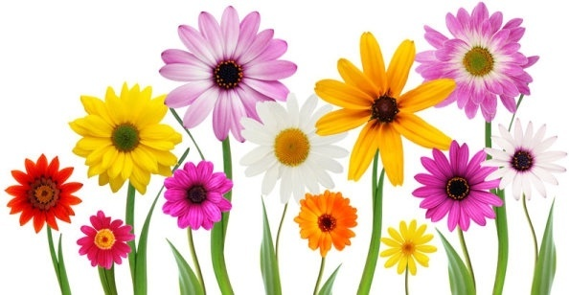
Welcome

Slide 2
Teacher’s Identity
Md. Abu Jahed
Assistant Teacher
S. Halishahar Ahammadia Govt. Primary school.

Slide 3
Lesson Introduction
Sub: English
Class: Five
Unit: 20
Lesson: Life is Beautiful!
( It’s a beautiful …..day.)
Time: 40 minutes
Date: 07 /02/2017

Slide 4
Learning Outcomes:
Student Will be able to:
Listening skill: 4.2.1 Understand and enjoy simple stories.
Speaking Skill: 3.1.1 Ask and answer WH question.
Reading skill: 5.1.2 Read silently with understanding stories.
Writing skill:10.2.1 write short and simple composition on familiar objects such as people, place and events

Slide 5
Let’s see a video

Slide 6

Today we will learn about a visually impaired girl. Our topic is-
Life is Beautiful !

Slide 7
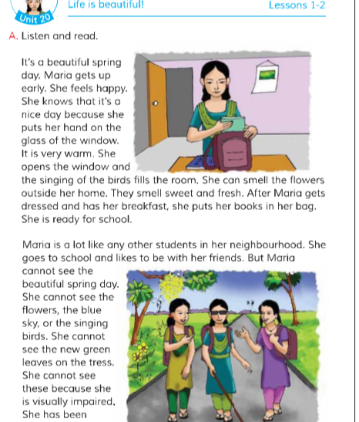
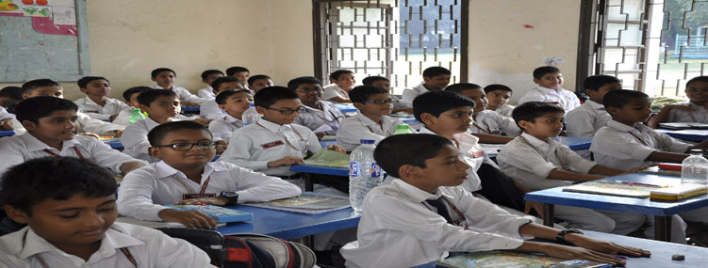
Teacher’s & Student’s reading
Open Your book at page 78

Slide 8
Let’s know some words:
Neighbourhood
People who live near our house
Warm
Very Hot
Smell
To feel anything by nose
Spring
One of the seasons name
Visually Impaired
Blind, Cannot see

Slide 9



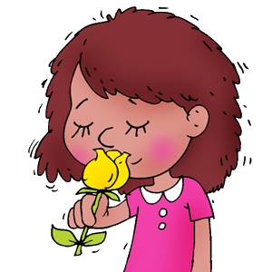
Blind or Visually impaired
Neighborhood
smell
spring

Slide 10
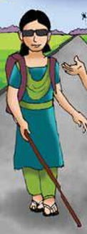
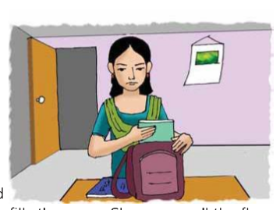
Who is she?
How is Maria?
Maria
Blind or Visually impaired

Slide 11
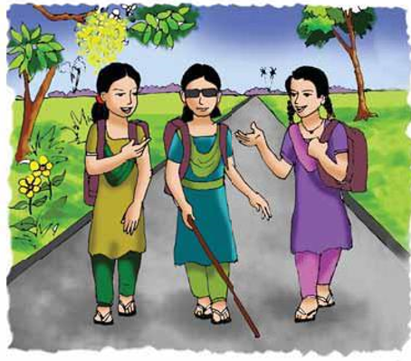
Where Is Maria?

Slide 12

It’s a beautiful spring day.]

Slide 13
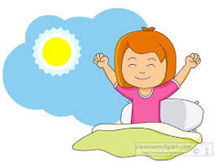
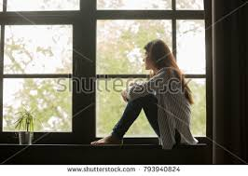
It’s a beautiful Spring day. Maria gets up early. She feels happy
She knows that it’s a nice day because she puts her hand on the glass of the Window. It is very Warm.

Slide 14
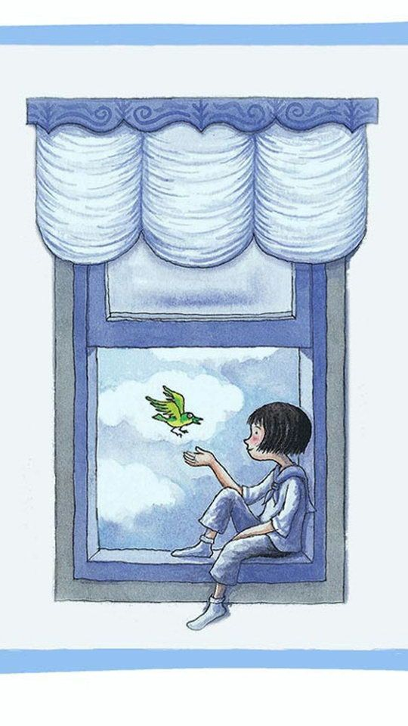
She opens the window and the singing of the birds fills the room

Slide 15
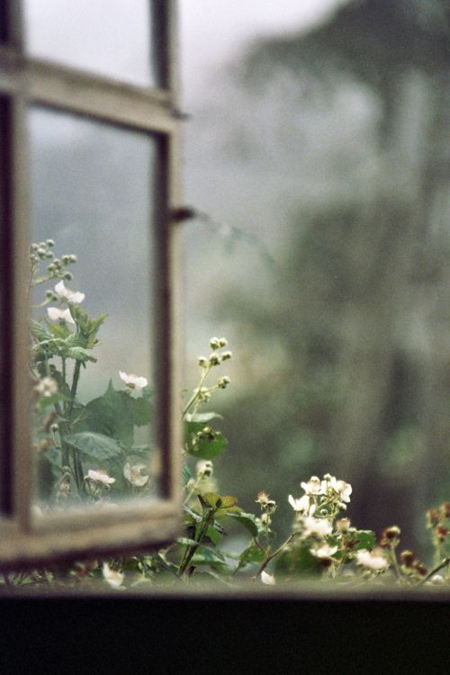
She can smell the flowers outside her home. They smell sweet and fresh.

Slide 16

After Maria gets dressed and has her breakfast, she puts her books in her bag. She is ready for school.

Slide 17
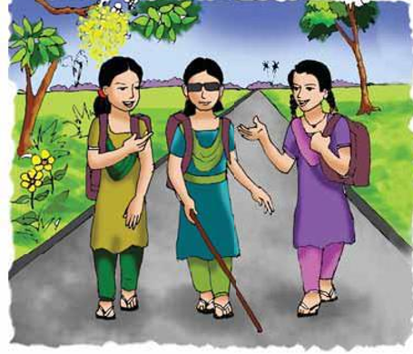
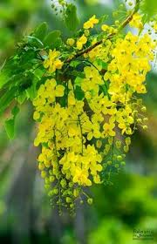
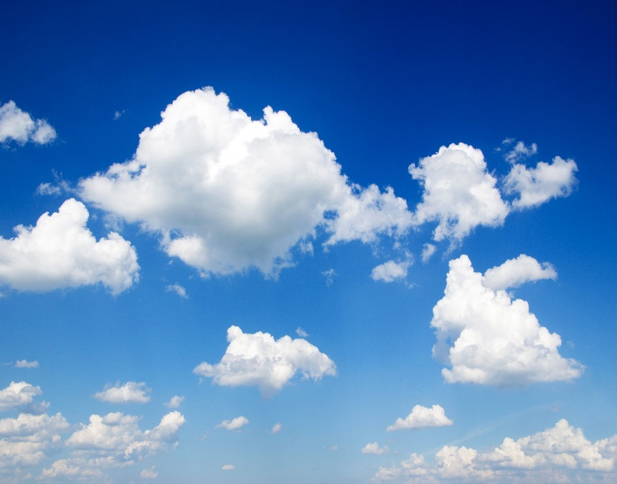
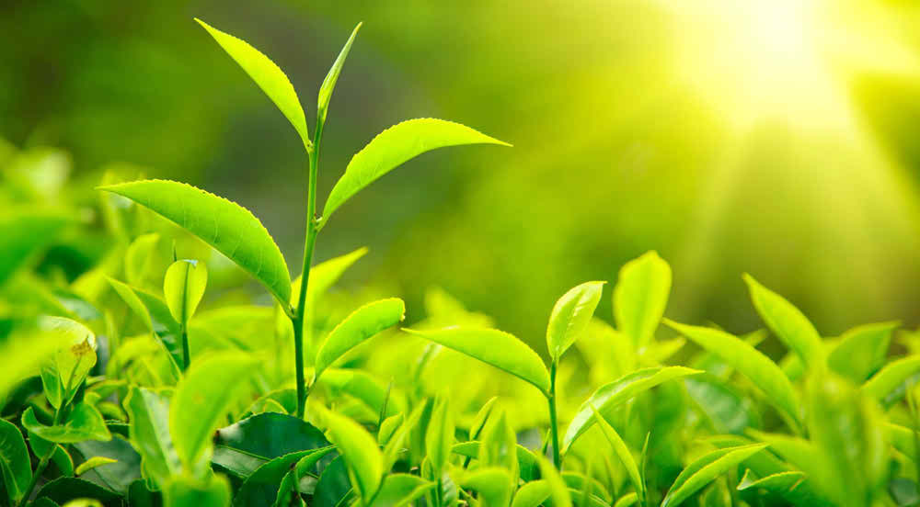
The flowers
The blue sky
Maria is a not like any others students in her neighbourhood. She goes to school and likes to be with her friends. But Maria cannot see the flower, the blue sky, or the singing birds.
New green leaves

Slide 18
Group Work
Padma
Meghna
Jamuna
Answer the short question:
When does Maria get up?
How was the day?
a)Maria feels…………………..
Happy 2) sad 3) bad 4) nothing
b) Maria cannot see………..
1)Flower 2)blue sky 3) bird 4)Nothing
Fill in the blanks
Maria can smell sweet and …………. .
b) Mari cannot see the ……….. Spring day.

Slide 19
Evaluation
Write a short composition about Maria by answering the following question.
When does Maria get up?
b) How does feel Maria?
c)Where does she can smell the flowers?
d)When does she put her books in her bag?
e) Why she cannot see the beautiful Spring day?

Slide 20
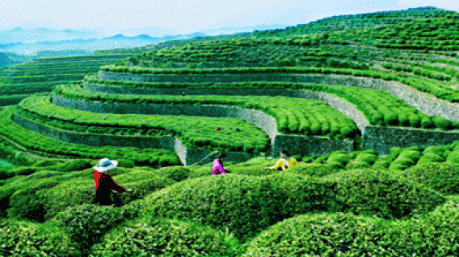
Thanks a lot

